Slide 2
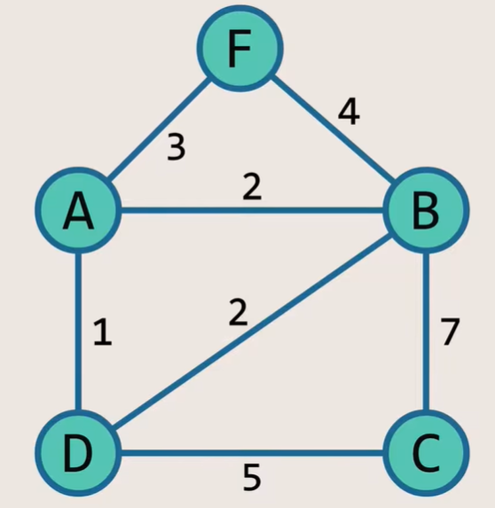
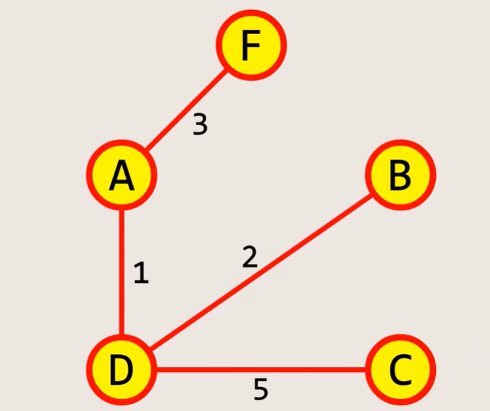
Kruskal's Algorithm ||Disjoint Sets ||Union By Rank||Path Compression
Arrange all edges in ascending order
1
2
2
3
4
5
7
Minimum spanning tree of given graph

Slide 3
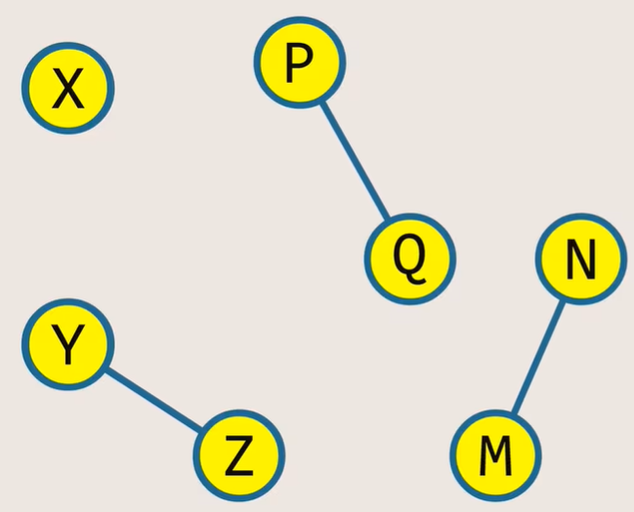
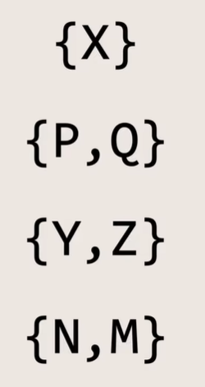
Kruskal's Algorithm ||Disjoint Sets
Note :If two elements are in different sets that means they are not connected
If two elements are in same set they are connected

Slide 4
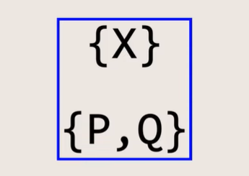
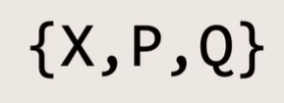
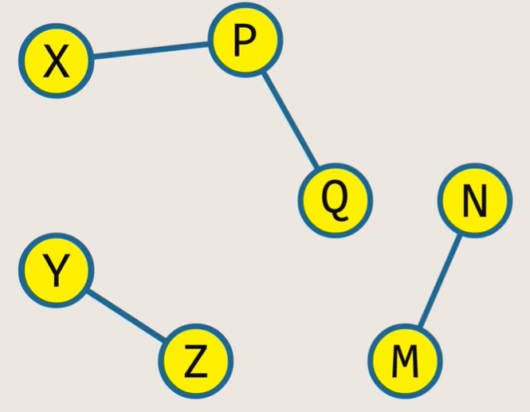
Kruskal's Algorithm ||Disjoint Sets

Slide 5
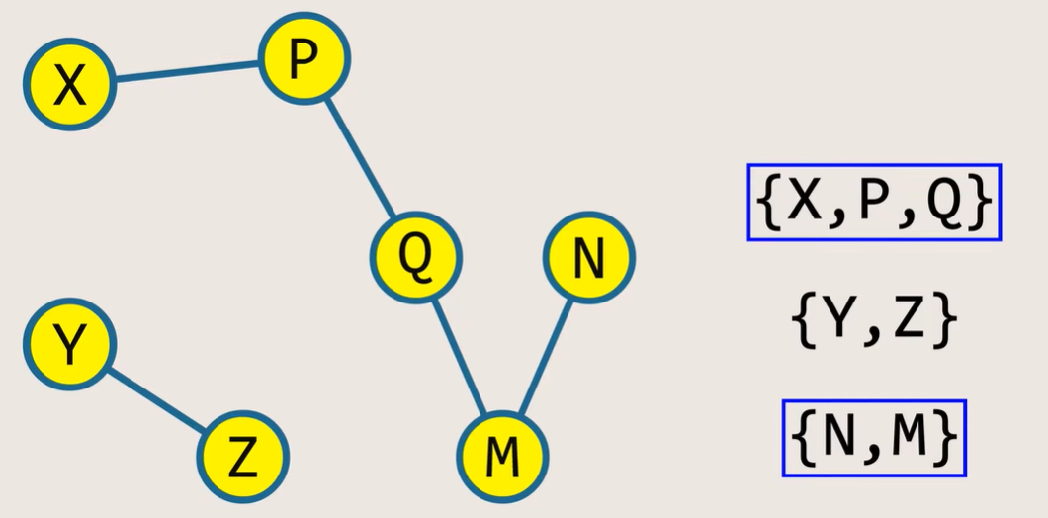
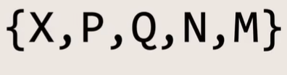
Kruskal's Algorithm ||Disjoint Sets

Slide 6
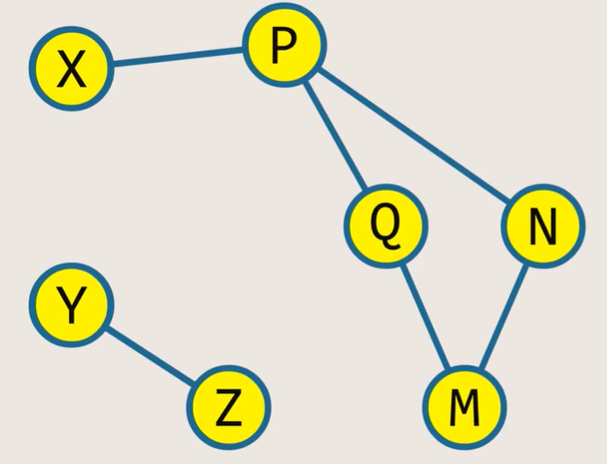
Kruskal's Algorithm ||Disjoint Sets|| Cycle Detection
Cycle Detected because elements P and N are in same set

Slide 7
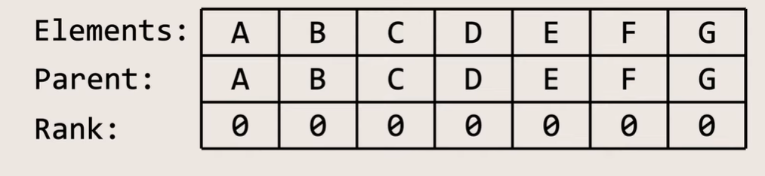

Kruskal's Algorithm ||Disjoint Sets
How Disjoint Sets Work
In above table each node has its own parent which means each element has its own root
In this stage each element is in its own separate set

Slide 8
Kruskal's Algorithm ||Disjoint Sets
Operations on Disjoint Sets
Find operation
Union operation
Find operation: Root compared with other element if they match both elements belong to same set.
Union Operation: Used to merge two sets

Slide 9
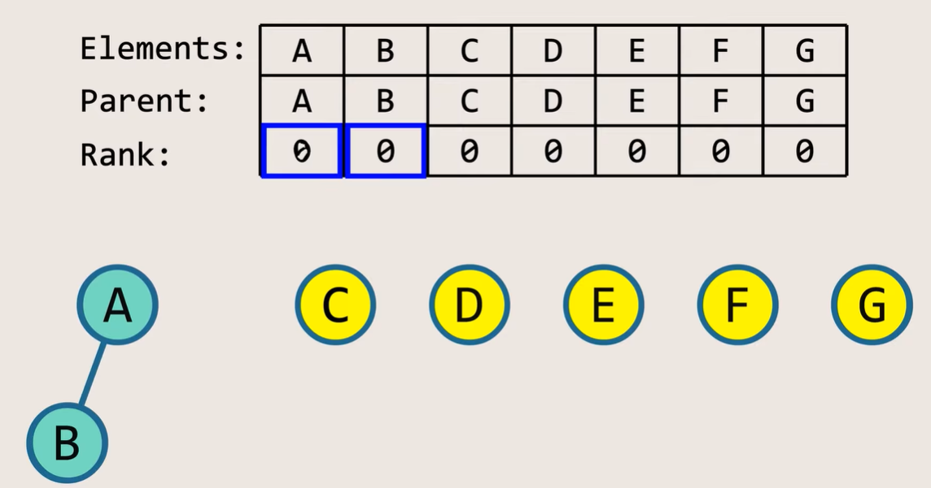
Kruskal's Algorithm ||Disjoint Sets

Slide 10
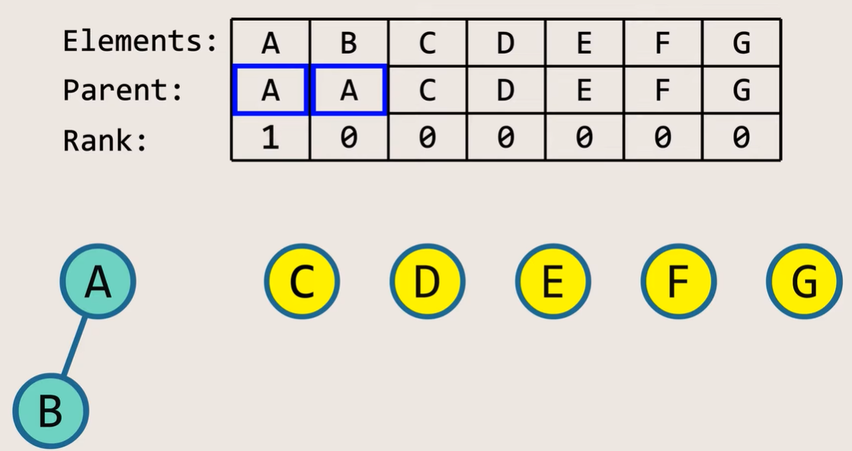
Kruskal's Algorithm ||Disjoint Sets

Slide 11
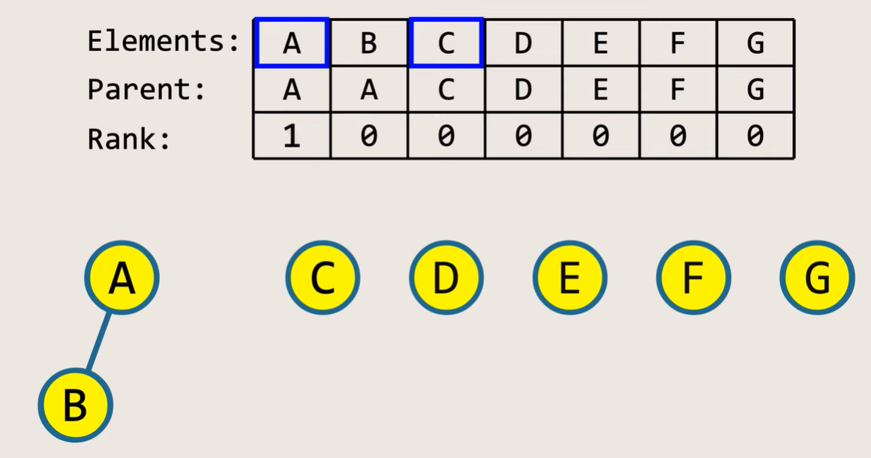
Kruskal's Algorithm ||Disjoint Sets
Union Operation on A & C

Slide 12
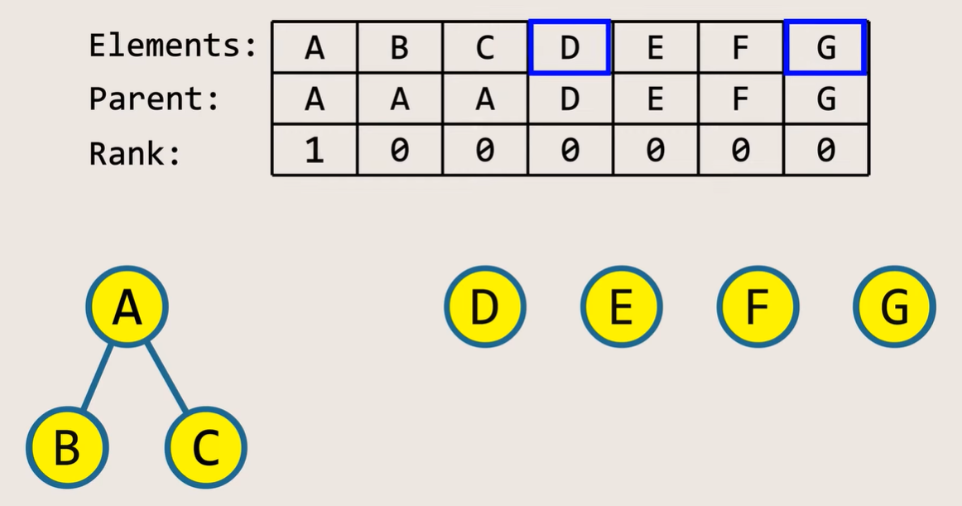
Kruskal's Algorithm ||Disjoint Sets
Union Operation on A & C

Slide 13
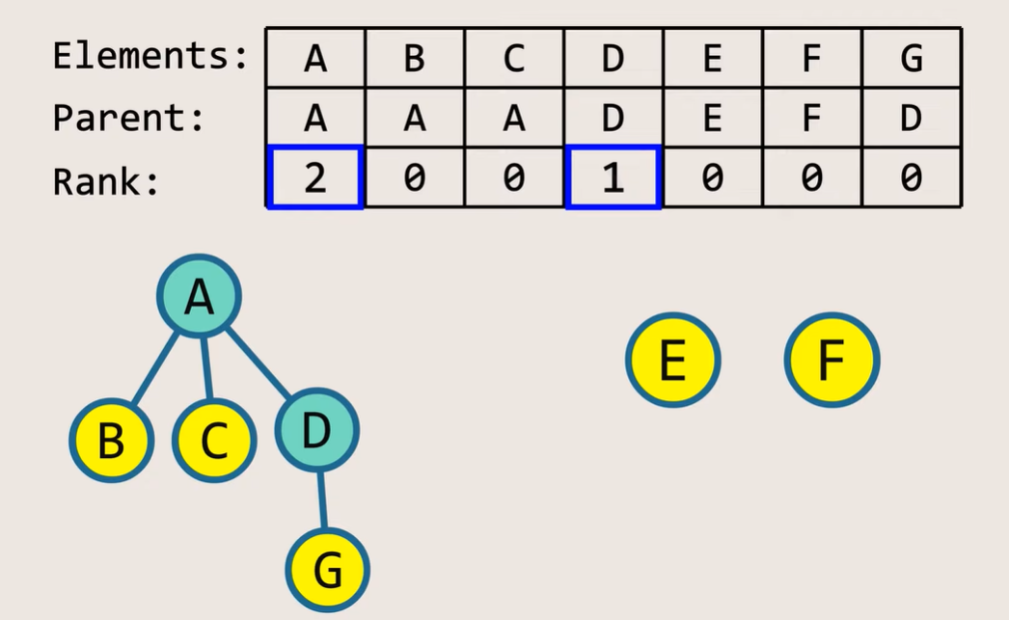
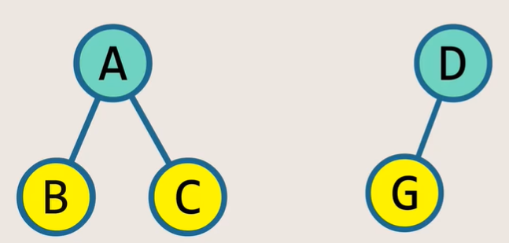
Kruskal's Algorithm ||Disjoint Sets
Union Operation on D & G

Slide 14
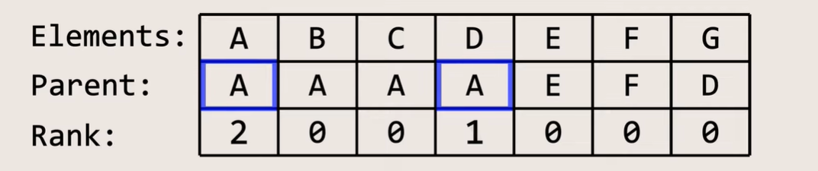
Kruskal's Algorithm ||Disjoint Sets
Union Operation on A & D

Slide 15
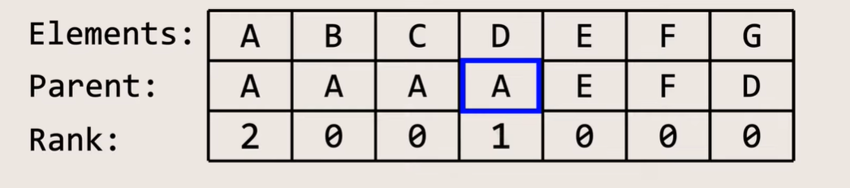
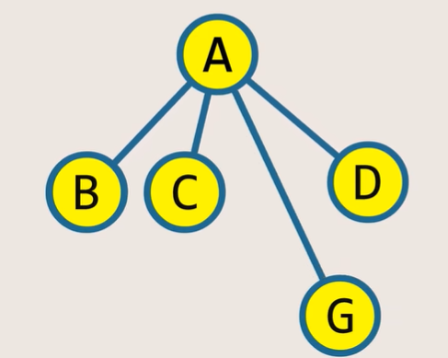
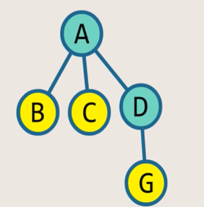
Kruskal's Algorithm ||path compression
Find Operation On G

